Slide 1

A new perspective on the equatorial Atlantic seasonal cycle
^{1,2}Lander R. Crespo, ^{1,2}Shunya Koseki, ^{1,2}Noel Keenlyside, ^{2,3}Yanchun He
¹ Geophysical Institute, Bergen. ² Bjerknes Center for Climate Research, Bergen.
³ Nansen Environmental and Remote Sensing Center, Bergen.
Methods
Methods
climSST
climSST_atm
Control
NorESM atmos
NorESM ocean
Observed SST
Sensitivity
eqmeanSST
eqmeanSST_atm
Results
Results
TRIATLAS GA Trial run #2 Online 20.04.2020
lander.crespo@uib.no

Slide 2

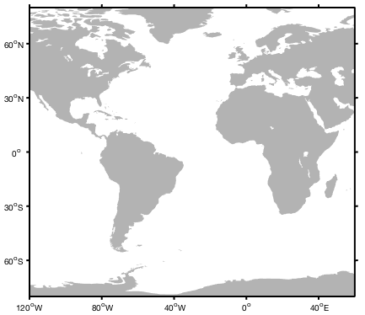
Personal and research career
BSc in fundamental physics. University of the Basque Country. Characterization of nanomagnetic materials
MSc in meteorology at the Complutense University of Madrid. A conceptual model for ENSO
PhD in climate dynamics at the University of Bergen. Ocean-atmosphere interactions in the tropical Atlantic seasonal cycle
Current position: Researcher in TRIATLAS at the University of Bergen. Seasonal-to-decadal predictability of climate and biogeochemical processes with NorCPM model.
Lander Crespo
PhD + Researcher
BSc
MSc
Extracurricular activities:
Mountain guide at university outdoor association.
Beer brewing club.
Photography and writing.
Surfing, climbing, trail running, ski mountaineering.
Seasonal cycle
ENSO

Slide 3
Motivation
Annual cycle eastern Tropical Atlantic
Spring
Summer
Crespo et al (2018)
Motivation
Methods
Results Atmos
Results Ocean
Conclusions

Slide 4
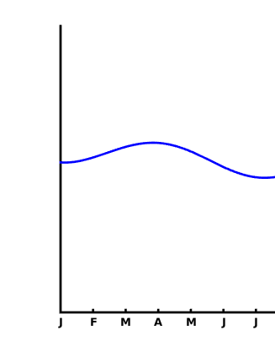
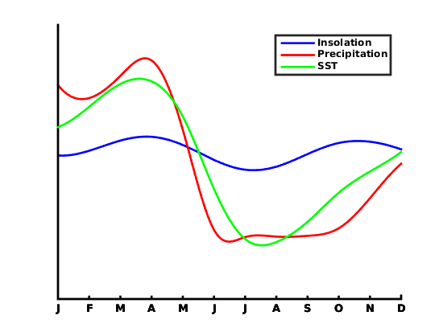
Motivation
Annual cycle eastern Tropical Atlantic
Spring
Summer
Summer
SST and precipitation follow the seasonal march of the sun until July
Motivation
Methods
Results Atmos
Results Ocean
Conclusions

Slide 5
Motivation
Annual cycle eastern Tropical Atlantic
Spring
What is behind the mismatch in the seasonal cycle between insolation and SST-precipitation??
?
Weak semiannual cycle
Summer
Strong annual cycle
Strong annual cycle
But not later in the year…
Motivation
Methods
Results Atmos
Results Ocean
Conclusions

Slide 6
Motivation
Annual cycle eastern Tropical Atlantic
Spring
Summer
West African Monsoon (WAM)
Change in wind direction:
Southeasterly -> southerly/southwesterly
Moisture transport from the ocean to land in west Africa
Atlantic Cold Tongue (ACT)
Intense cooling of the SST in the east
Motivation
Methods
Results Atmos
Results Ocean
Conclusions

Slide 7
Motivation
Annual cycle eastern Tropical Atlantic
Spring
Summer
West African Monsoon (WAM)
Ocean-atmosphere interactions
Atlantic Cold Tongue (ACT)
Motivation
Methods
Results Atmos
Results Ocean
Conclusions

Slide 8
Methods
Coupling ocn-atm eq Atlantic
How important is the coupling between the upper ocean and the atmosphere in the equatorial Atlantic seasonal cycle?
1- To what extent does the seasonal cycle in equatorial Atlantic SST influence that of the atmosphere?
Observed SSTs
Simulated atmosphere
climSST
climSST_atm
NorESM
atmos
eqmeanSST
eqmeanSST_atm
2- How much of the seasonal cycle of equatorial Atlantic SST can be explained by wind variations not driven by local SST?
Simulated atmosphere
Simulated ocean
climSST_atm
Control
NorESM
ocean
eqmeanSST_atm
Sensitivity
Motivation
Methods
Results Atmos
Results Ocean
Conclusions

Slide 9
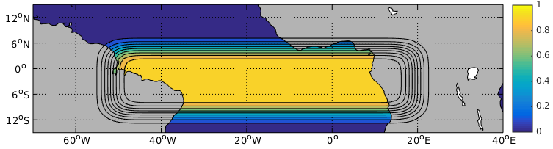
Methods
Atmospheric model simulations
Observed SSTs
Simulated atmosphere
climSST
climSST_atm
NorESM
atmos
eqmeanSST
eqmeanSST_atm
Norwegian Earth System model (NorESM) atmospheric component.
  Spatial resolution: 1.25°x0.9°
  26 vertical layers (low-top).
  Historical runs: from Jan 1982 to Dec 2013.
2 sensitivity experiments with prescribed SST as boundary conditions.
climSST
eqmeanSST
Seasonally varying SST globally. No interannual variability.
Annual mean SST at the equator (10S-5N) and seasonally varying elsewhere
Climatological SST
Annual mean SST
Motivation
Methods
Results Atmos
Results Ocean
Conclusions
Notes:
For this purpose, we designed a sort of Sensitivity Experiments. The main objective is understanding the impact of the tropical Atlantic SST on the monsoon. We made historical runs for the period 1982-2013 with the Norwegian Earth System Model (NorESM) atmospheric component CAM4 (developed by NCAR) in its finest resolution.
The atmospheric model is ran with prescribed SSTs as boundary conditions. What does it mean? The ocean component is not predicted by the model, but introduce as a forcing. We need to specify both SIC and SST.
We set the same SIC for every experiment because we want to analyze only the impact of the SST in the atmosphere. This way, the difference in the results of each experiment depend only on the different settings of the SST and not in the SIC. In the expA the SST is the fully observed varying field. In expB we eliminate the interannual variability (retaining only the SC). In expC we completely eliminate the variability, so we have a time-independent SST (same value for every timestep).

Slide 10
Methods
Ocean model simulations
Norwegian Earth System model (NorESM) ocean component
  Resolution: ca. 1º x 0.25º resolution at the equator.
  51 isopycnic layers + 2 non-isopycnic layers (surface mixed layer).
2 ocean model experiments forced with atmospheric model output data for the historical period 1948-2007.
Observed SSTs
Simulated atmosphere
Simulated ocean
climSST
climSST_atm
Control
NorESM
atmos
NorESM
ocean
eqmeanSST
eqmeanSST_atm
Sensitivity
The difference between the Control and Sensitivity experiments accounts for the relevance of the feedback between SST and atmosphere at the equator.
Motivation
Methods
Results Atmos
Results Ocean
Conclusions

Slide 11
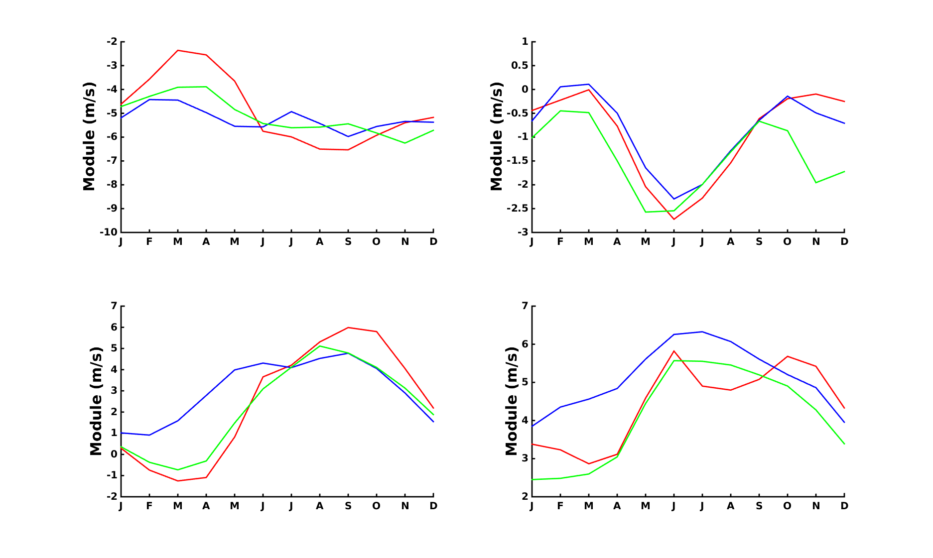
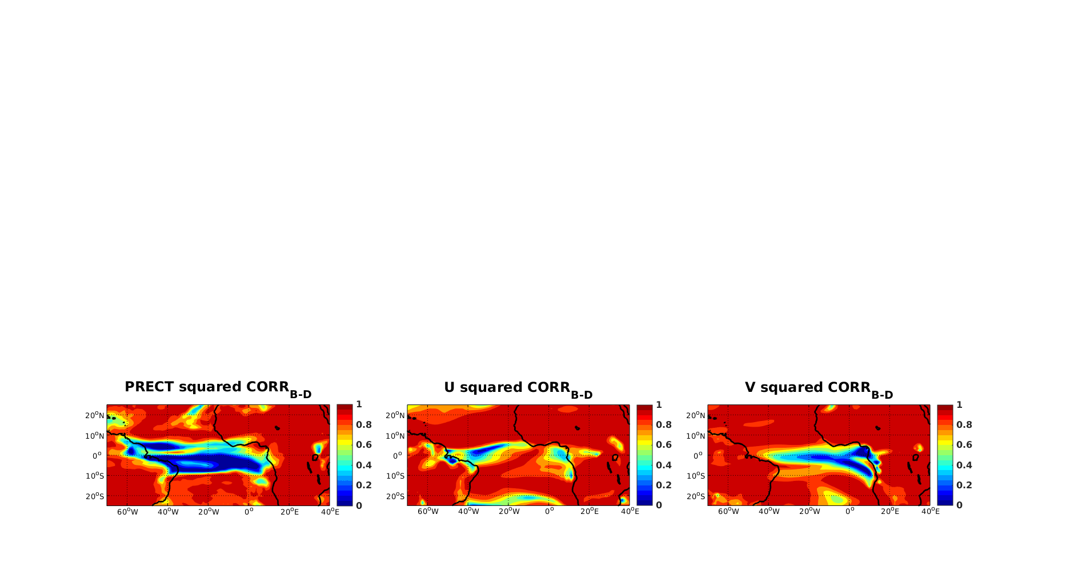
Results NorESM atmos
Seasonal cycle of the winds
Seasonal cycle precipitation
Variance not explained by eqSST
Coupled ocean-atmosphere modes
Motivation
Methods
Results Atmos
Results Ocean
Conclusions

Slide 12
Results Atmos
Seasonal cycle of the winds
Zonal wind
Zonal wind
climSST
eqmeanSST
JRA
Meridional wind
Meridional wind
Motivation
Methods
Results Atmos
Results Ocean
Conclusions

Slide 13
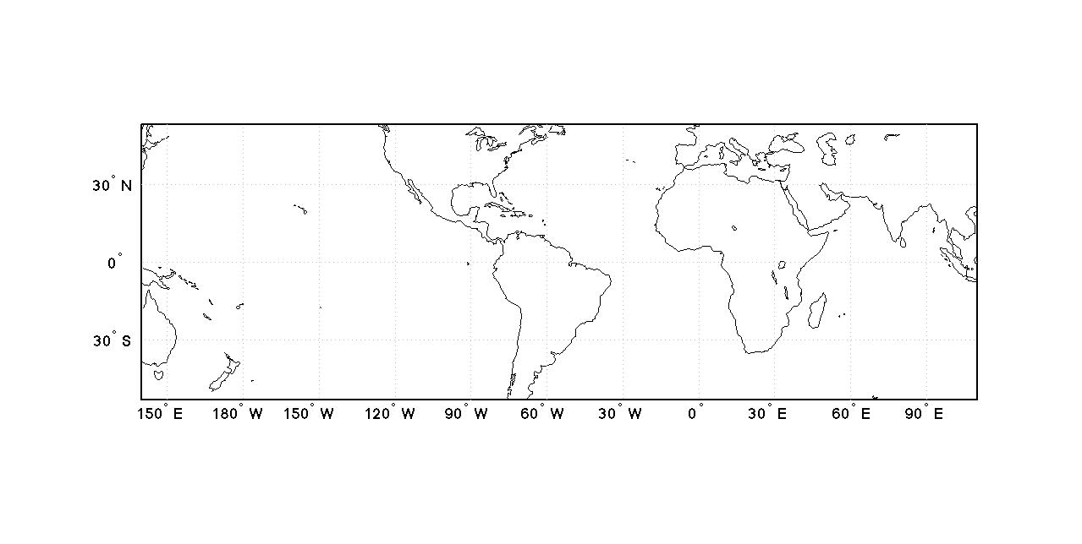
Results Atmos
Seasonal cycle of the winds
Zonal wind
Seasonal cycle in zonal winds largely reduced.
Seasonal cycle of meridional winds weaker.
Seasonal cycle of SST is a key driver of the surface winds in the west.
climSST
eqmeanSST
JRA
Meridional wind
western equatorial Atlantic
(WEA)
WEA
Motivation
Methods
Results Atmos
Results Ocean
Conclusions

Slide 14
Results Atmos
Seasonal cycle of the winds
Zonal wind
Zonal wind insensitive to seasonal changes of equatorial SST in the east.
climSST
eqmeanSST
JRA
The onset of the monsoon (abrupt jump in the meridional wind) is missed without seasonal changes in equatorial SST.
Meridional wind
eastern equatorial Atlantic
(EEA)
EEA
Motivation
Methods
Results Atmos
Results Ocean
Conclusions

Slide 15
Results Atmos
Seasonal cycle precipitation
Motivation
Methods
Results Atmos
Results Ocean
Conclusions

Slide 16
Results Atmos
Variance not explained by eqSST
Squared correlation of climSST - eqmeanSST
U
V
Motivation
Methods
Results Atmos
Results Ocean
Conclusions
Notes:
SST main trigger of the precipitation along equatorial Atlantic
SST considerable impact over west African continental precipitation.
Low-level winds controlled by precipitation except for the the zonal wind in EEA region.

Slide 17
Results Atmos
Coupled O-A mode at the equator
Maximum Covariance Analysis of climSST-eqmeanSST
SST
PRECT & winds
Motivation
Methods
Results Atmos
Results Ocean
Conclusions
Notes:
I used a Maximum Covariance Analysis statistical technique to find the dominant coupled ocean-atmosphere mode at the equator. These panels show the difference between climSST and eqmeanSST simulations show the mode related to the seasonal anomalies of SST at the equator. The SST pattern on the left is tightly related to the precipitation and surface winds pattern in the central panel. The left panel shows the time evolution of this mode. This mode explains for more than 95% of the variance. The SST dominates the seasonal cycle of the atmosphere in the western equatorial Atlantic and also has significant impacts in the east and on the coastal precipitation over the west African continent.

Slide 18
Results Atmos
Coupled O-A mode at the equator
Maximum Covariance Analysis of climSST-eqmeanSST
SST
PRECT & winds
Equatorial SST controls precipitation and surface winds in the west-to-central Atlantic.
Equatorial SST drives part of the coastal precipitation over the west African continent.
Motivation
Methods
Results Atmos
Results Ocean
Conclusions
Notes:
I used a Maximum Covariance Analysis statistical technique to find the dominant coupled ocean-atmosphere mode at the equator. These panels show the difference between climSST and eqmeanSST simulations show the mode related to the seasonal anomalies of SST at the equator. The SST pattern on the left is tightly related to the precipitation and surface winds pattern in the central panel. The left panel shows the time evolution of this mode. This mode explains for more than 95% of the variance. The SST dominates the seasonal cycle of the atmosphere in the western equatorial Atlantic and also has significant impacts in the east and on the coastal precipitation over the west African continent.

Slide 19
Take home points
The seasonal cycle of the SST is a major driver of the surface winds and precipitation in the western equatorial Atlantic.
- The monsoon is the main driver of the seasonal cycle of meridional winds and precipitation in the eastern equatorial Atlantic, and the SST also plays and important role there.
- The zonal winds in the central and eastern equatorial Atlantic are insensitive to changes in the underlying SST.
Motivation
Methods
Results Atmos
Results Ocean
Conclusions

Slide 20
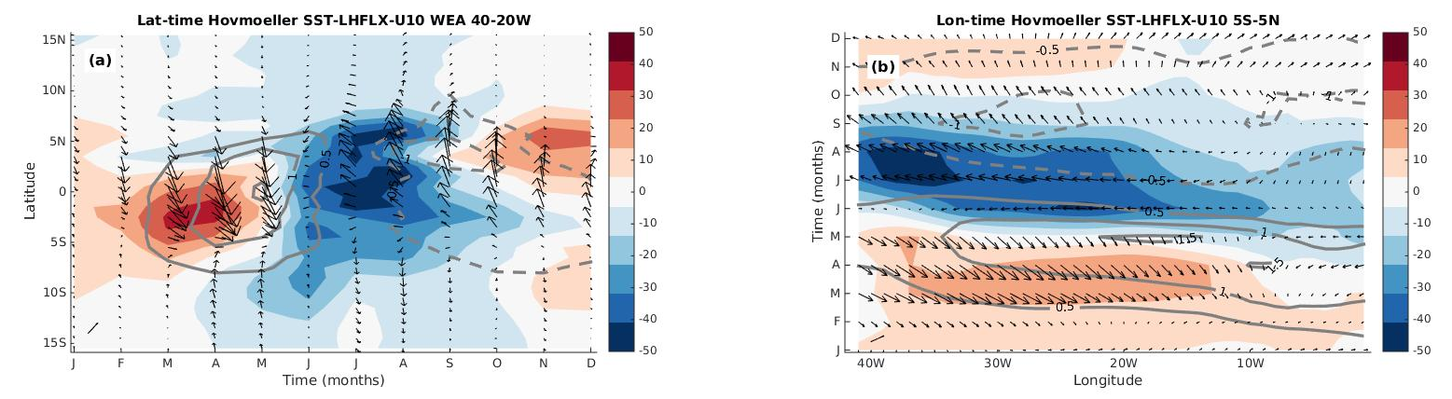
Results NorESM ocean
Seasonal cycle TAUX, and SST
Seasonal heat budget
Mechanism of O-A coupling
Dynamics of the seasonal cycle
Motivation
Methods
Results Atmos
Results Ocean
Conclusions

Slide 21
Results Ocean
Seasonal cycle of TAUX, SST and SSH
Observations
Control
Sensitivity
Difference
Motivation
Methods
Results Atmos
Results Ocean
Conclusions
Notes:
Hovmöller diagrams of the seasonal cycle of (left column) TAUX (zonal wind stress), (central column) SST and (right column) sea surface height (SSH) for (first row) observations, (second row) Control, (third row) Sensitivity and Control minus Sensitivity (fourth row) simulations

Slide 22
Results Ocean
Seasonal cycle of TAUX, SST and SSH
Sensitivity in the EEA
The phasing of the SST is well captured (strong annual cycle).
The amplitude is reduced in 70% in spring and 50% in summer.
Observations
Control
Sensitivity
Sensitivity simulation in the WEA:
The amplitude of the SST is drastically reduced in agreement with the differences in the wind forcing.
Difference
Motivation
Methods
Results Atmos
Results Ocean
Conclusions

Slide 23
Results Ocean
Seasonal cycle of TAUX, SST and SSH
Differences in the EEA:
The differences in the seasonal cycle of the SSH DO explain the differences in the seasonal cycle of the SST between simulations in the eastern equatorial Atlantic.
Those SSH anomalies are not locally forced -> the zonal surface winds show same seasonal cycle in the east.
Observations
Control
Differences in the WEA:
The differences in the seasonal cycle of SSH DO NOT explain the differences in the seasonal cycle of the SST between simulations in the west.
Sensitivity
Difference
Motivation
Methods
Results Atmos
Results Ocean
Conclusions

Slide 24
Results Ocean
Seasonal heat budget
Control
Sensitivity
Difference
Motivation
Methods
Results Atmos
Results Ocean
Conclusions

Slide 25
Results Ocean
Seasonal heat budget
What explains the intense summer cooling in the SST in EEA?
The weaker evaporation around summer in Sensitivity experiment can explain around 30% of the difference of the SST cooling.
The remaining 70% of the cooling is explained by the residual term (vertical processes).
Control
Sensitivity
Difference
Motivation
Methods
Results Atmos
Results Ocean
Conclusions

Slide 26
Results Ocean
Seasonal heat budget
What explains the intense summer cooling in the SST in EEA?
The weaker evaporation around summer in Sensitivity experiment can explain around 30% of the difference of the SST cooling.
The remaining 70% of the cooling is explained by the residual term (vertical processes).
Control
What explains the seasonal cycle in the SST in WEA?
The differences in the SST in the west are explained by the differences in the heat flux terms, mainly evaporation due to reduced surface winds in Sensitivity experiment there.
Sensitivity
Difference
Motivation
Methods
Results Atmos
Results Ocean
Conclusions

Slide 27
Results Ocean
Seasonal heat budget
mixed-layer temperature tendency
advection by surface currents
air-sea
heat fluxes
meridional advection
zonal advection
H = 50m
Motivation
Methods
Results Atmos
Results Ocean
Conclusions

Slide 28
Results Ocean
WES feedback in the west
Wind-Evaporation-SST feedback
Wind anomalies -> latent heat flux anomalies -> SST anomalies
Active WES feedback in the western equatorial Atlantic.
Chang and Philander (1994); Chang et al (1997)
Motivation
Methods
Results Atmos
Results Ocean
Conclusions
Notes:
Latitude-time Hovmoeller diagrams of the difference between Control and Sensitivity simulations longitudinally averaged for WEA region (40º-20ºW) of (a) latent heat flux anomalies (shading), wind speed anomalies at 10m (arrow vectors) and SST anomalies (contours). (b) Longitude-time Hovmoeller diagrams latitudinally averaged from 5ºS-5ºN of the same fields as in (a). Positive (negative) latent heat flux anomalies indicate downward (upward) flux; i.e. ocean gains (losses) heat. Dashed and solid contour lines indicate negative and
positive anomalies respectively. Blue and red shading indicates negative and positive anomalies respectively. Note that all the anomalies here represent the role of the SST-atmosphere feedback at the equator. This feedback is limited to 10ºS-5ºN since the atmosphere that forces the Sensitivity experiment has seen an annual mean SST along that latitude band.

Slide 29
Results Ocean
WES feedback in the west
Wind-Evaporation-SST feedback
WES feedback
Motivation
Methods
Results Atmos
Results Ocean
Conclusions
Notes:
Imagine that we have the sun north of the equator and associate warm SST anomaly north of the equator and cold anomaly south of the equator. This will induce a sea-level-pressure gradient and a crossequatorial wind component.

Slide 30
Results Ocean
WES feedback in the west
Wind-Evaporation-SST feedback
WES feedback
Motivation
Methods
Results Atmos
Results Ocean
Conclusions
Notes:
The cross-equatorial wind component will deflect to the left south of the equator and to the right north of the equator due to Coriolis effects. Taking into account now that the background winds are easterlies, the effect is acceleration of the trade winds south of the equator and weakening north of the equator, which enhances (reduces) evaporation south (north of the equator) and reinforces the initial SST anomaly so the feedback loop is closed.

Slide 31
Results Ocean
Dynamics of the seasonal cycle
Motivation
Methods
Results Atmos
Results Ocean
Conclusions

Slide 32
Results Ocean
Dynamics of the seasonal cycle
Active WES feedback in the western equatorial Atlantic.
  Westerly wind - less evaporation - warmer SST
Westerly wind anomaly modifies sea level height generating westward travelling Rossby waves in the ocean.
Motivation
Methods
Results Atmos
Results Ocean
Conclusions
Notes:
In March-April the WES feedback is active in the WEA

Slide 33
Results Ocean
Dynamics of the seasonal cycle
The westward travelling Rossby waves reach the western boundary and travel equatorward as coastal Kelvin waves.
When the coastal Kelvin waves reach the equator they are reflected as eastward travelling equatorial Kelvin waves.
Motivation
Methods
Results Atmos
Results Ocean
Conclusions

Slide 34
Results Ocean
Dynamics of the seasonal cycle
In summer in the EEA the Atlantic Cold Tongue is established due to:
  - ITCZ and maximum insolation north of the equator
  - Active monsoon -> strong meridional winds cool down the SST
  - Upwelling Kelvin waves from the west intensify the upwelling.
Active WES feedback in the central equatorial Atlantic.
  Easterly wind - more evaporation - warmer SST
Motivation
Methods
Results Atmos
Results Ocean
Conclusions

Slide 35
Results Ocean
Dynamics of the seasonal cycle
The cold SST anomalies in the eastern equatorial Atlantic dissapear due to a higher insolation and the warm anomalies related to the WES feedback.
Motivation
Methods
Results Atmos
Results Ocean
Conclusions

Slide 36
Results Ocean
Dynamics of the seasonal cycle
Motivation
Methods
Results Atmos
Results Ocean
Conclusions

Slide 37
Conclusions
NorESM_atmos simulates a seasonal cycle in the atmosphere when forced with non-varying equatorial SSTs.
NorESM_ocean reproduces a significant amount of the seasonal cycle variability at the equator when forced by winds not produced by local SST.
The upwelling is the main contributor to the upwelling in summer in the Atlantic Cold Tongue region and is remotely triggered from the west.
Strong evaporation driven by monsoonal winds strongly contributes to the development of the cold tongue.
The coupling between the ocean and the atmosphere in the equatorial Atlantic is mainly thermodinamically driven (WES feedback) and is strongest in the west.
Motivation
Methods
Results Atmos
Results Ocean
Conclusions

Slide 38
References
Crespo, L.R., Keenlyside, N. & Koseki, S. The role of sea surface temperature in the atmospheric seasonal cycle of the equatorial Atlantic. Clim Dyn 52, 5927–5946 (2019). https://doi.org/10.1007/s00382-018-4489-4
Chang, P., and S. G. Philander, 1994: A Coupled Ocean–Atmosphere Instability of Relevance to the Seasonal Cycle. J. Atmospheric Sci., 51, 3627–3648, doi:10.1175/1520- 0469(1994)051<3627:ACOIOR>2.0.CO;2.
Chang, P, L. Ji, and H. Li, 1997: A decadal climate variation in the tropical Atlantic Ocean from thermodynamic air-sea interactions. Nature, 385, 516–518, doi:10.1038/385516a0.
Motivation
Methods
Results Atmos
Results Ocean
Conclusions

