Slide 1

Climate prediction vs climate projections
Discussion on marine ecosystem applications in the tropical Atlantic
Noel Keenlyside
University of Bergen and Bjerknes Centre for Climate Research
Bjerkes Climate Prediction Unit
https://bcpu.w.uib.no

Slide 2
Climate prediction vs climate projections
Meehl et al. 2009

Slide 3

Take home message: Climate prediction can build understanding, confidence, and be of immediate use!
Long-term climate change has and will profoundly impact marine ecosystems
Major uncertainties exists in understanding and modelling marine ecosystems and regional climate change, limiting our ability to provide comprehensive picture on future changes.
Can and do fisheries sector and policy makers use such uncertain information?
We can provide them an alternative:
Climate variability and extremes also impact marine ecosystems
Our ability to predict climate on these time scales is advancing rapidly
Developing climate based outlooks of marine ecosystem changes on seasonal to several years can build understanding, confidence, and be of immediate use!
https://triatlas.w.uib.no
TRIATLAS receives funding from the European Union's Horizon 2020 research and innovation programme under grant agreement no. 817578.

Slide 4
Navigate this i-poster
Climate change
Observed and simulated long-term changes in the tropical Atlantic
Sources of uncertainties in climate change
Large uncertainties in future climate change projections
Marine ecosystems
Examples of climate impacts on marine ecosystems in the tropical Atlantic
Example of potential of predictions: Barents Sea Cod Predictions
Climate prediction
Why are climate predictions of interest?
How do we make a prediction?
What level of skill exists?
Take home message
Discussion points

Slide 5
Observed and simulated long-term change in the tropical Atlantic
Back to main panel

Slide 6
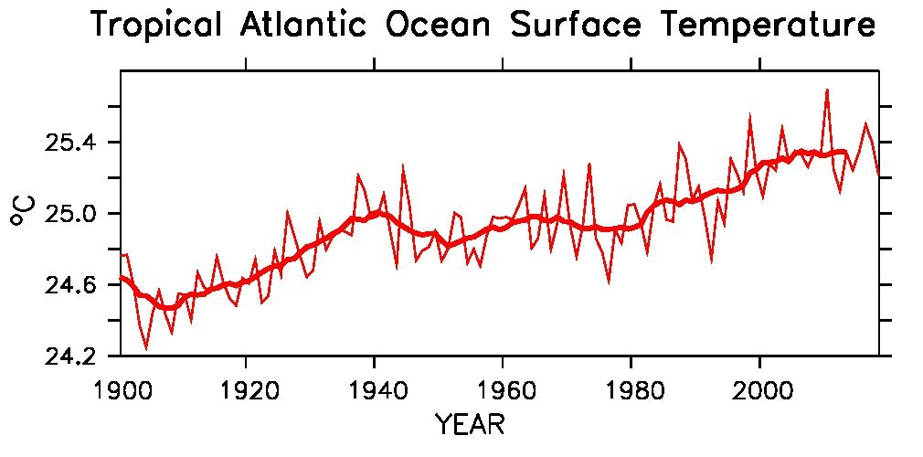
Causes of short and long-term changes in climate
Long-term trend caused mainly by global warming
Decade to decade changes caused by both natural and anthropogenic factors
Year to year fluctuations caused by natural processes in the climate system
Back to main panel

Slide 7
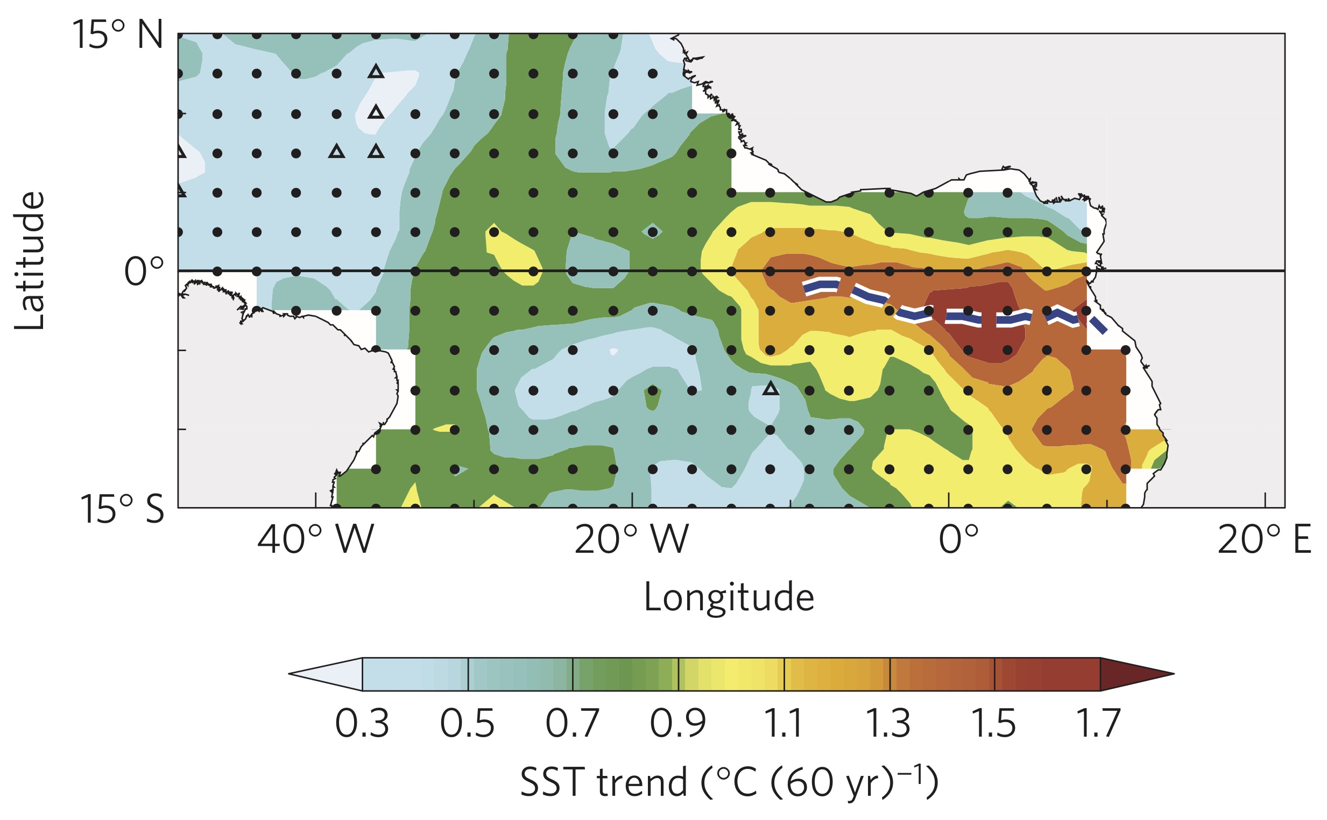
SST trend patterns sensitive to period
1950-2009 SST trend in JJA
Weakening of equatorial cold tongue
Tokinaga and Xie 2011
1979-2018 SST trend in JAS
Warming hole in the Equatorial Atlantic
Nnamchi et al. 2020
Back to main panel

Slide 8
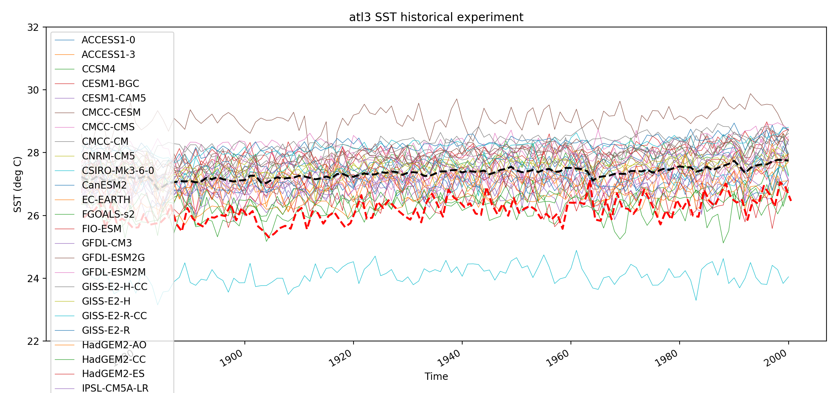
Large uncertainties in simulating historical climate
Sea surface temperature in the equatorial Atlantic cold tongue (ATL3 index)
Dashed black = Multi-model mean
HadISST
Courtesy: Lander Crespo
Back to main panel

Slide 9
Sources of uncertainties in climate change projections
Back to main panel

Slide 10
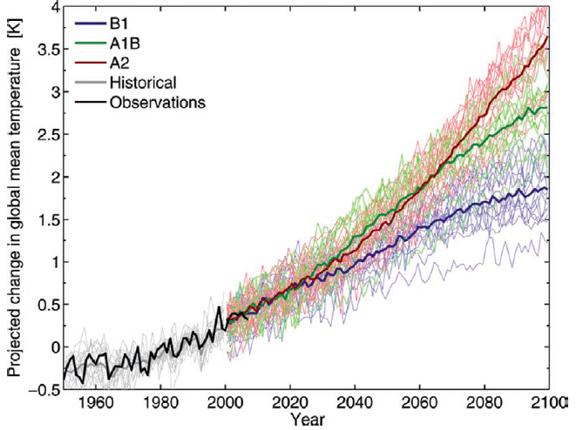
Uncertainties in long-term climate change projections:
Scenario, model, and internal
Surface temperature projections from 15 climate models
scenario
Model
Internal
Hawkins and Sutton, BAMS, 2009
Back to main panel

Slide 11
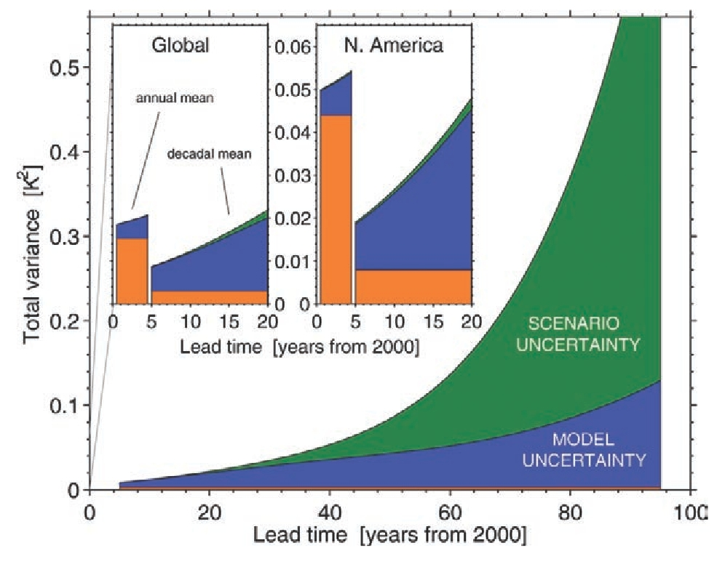
Relative importance of different uncertainties
Relative importance computed from CMIP3 models
Uncertainties grow with time
Scenario uncertainty important on long time and global scales
Internal variability important on short time and regional scales
Model uncertainty important on all scales, it dominates at regional and on decadal times scales
Back to main panel
Hawkins and Sutton, BAMS, 2009

Slide 12
Large uncertainties in future climate change in the tropical Atlantic
Back to main panel

Slide 13
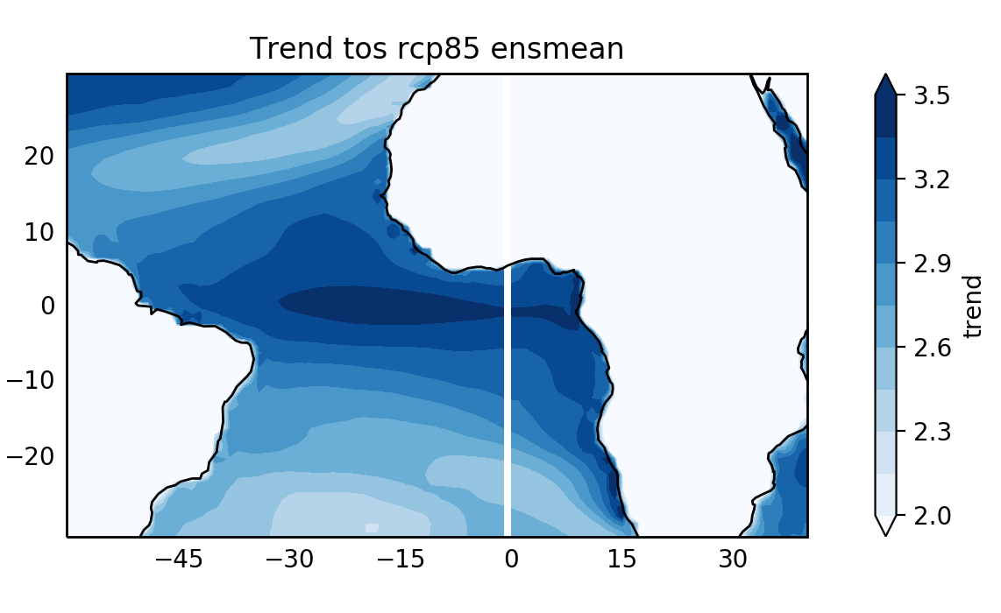
Larger warming rate in the equatorial Atlantic and Angola-Benguela region
Sea surface temperature trend from CMIP5 models over 21st century, RCP8.5 (deg/century)
Back to main panel
Courtesy: Lander Crespo

Slide 14
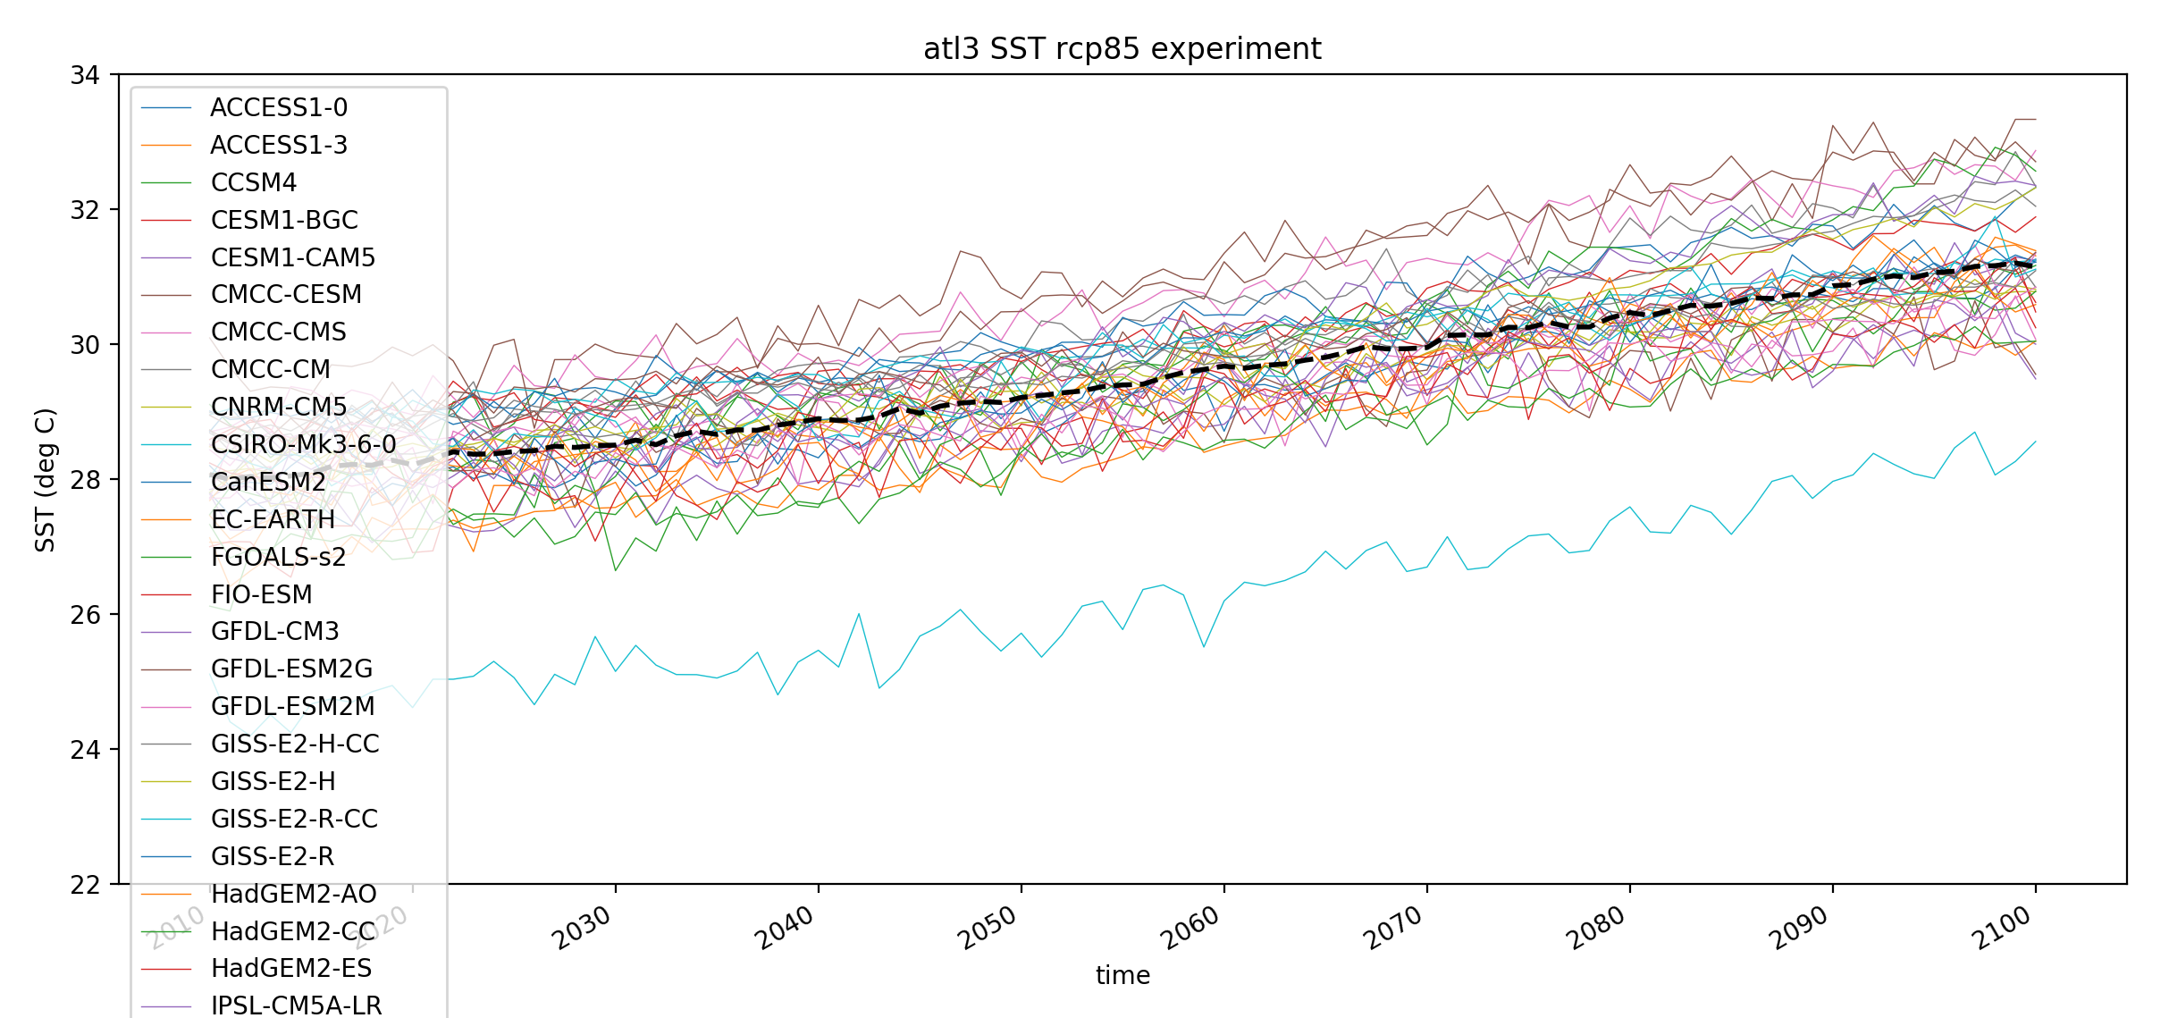
Large uncertainties in simulating historical climate
Sea surface temperature in the equatorial Atlantic cold tongue (ATL3 index)
Dashed black = Multi-model mean
Courtesy: Lander Crespo
Back to main panel

Slide 15
Model biases in the South Eastern Tropical Atlantic among the most severe
CMIP5 multi-model mean sea surface temperature error
Richter, WIRES, 2015
°C
Back to main panel

Slide 16
Climate change: Atlantic Niño warming when warm bias reduced
Sea surface temperature change: 2080-2100 minus 1980-2000
Standard NorESM
Anom. Coupled NorESM
Courtesy: Teferi Demissie
Back to main panel

Slide 17
Importance of internal climate variability
Back to main panel

Slide 18
Internal variability can enhance or weaken externally forced climate change
Observed time series
10 year running mean,
and yearly values
CMIP3 historical simulations
Dashed - ensemble mean
Grey shading – 90% confidence interval
Keenlyside and Ba, 2010
Back to main panel

Slide 19
Internal variability has strong regional expression
Surface temperature trends from 1978 - 2008
Observations
CMIP3 multi-model mean
Degrees Celsius per decade
Keenlyside and Ba, 2010
Back to main panel

Slide 20
Internal variability results from interactions among climate components
Atlantic multi-decadal variability (AMV)
Keenlyside and Ba, 2010
Impacts include droughts over Sahel and North America, hurricane activity, European climate
Back to main panel

Slide 21
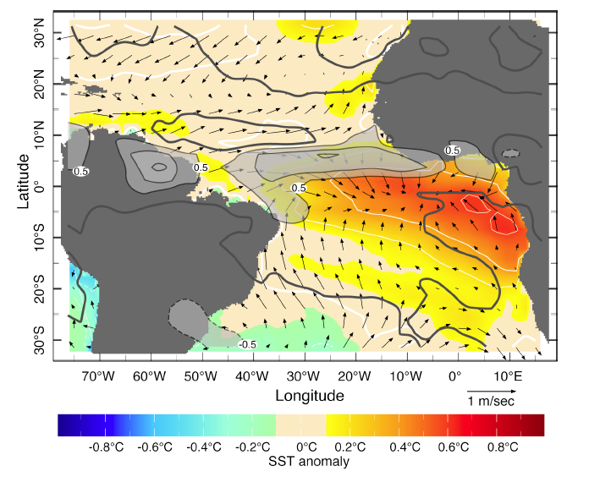
Some more familiar patterns of internal climate variability
El Niño Southern Oscillation has major impacts in the tropical Atlantic
Atlantic Niño
First EOF of June-August precipitation
Linearly related SST and surface wind vectors
Sea Surface Temperature – November 2015
Stockdale et al. 2017, ECMWF, Newsletter
Chang et al. 2006
Back to main panel

Slide 22
Making a climate prediction
Back to main panel

Slide 23
Making a climate change projection
External radiative forcing
Projections focusing on centennial, and global scales
Earth System Model
IPCC, 2013
Image source NOAA
Back to main panel

Slide 24
Making a climate change prediction
External radiative forcing
Prediction focusing on seasons to years, and regional scales
Earth System Model
Observations
Image source NOAA
Synchronize the model with observations, for example, using data assimilation
Back to main panel
Foltz et al. 2019

Slide 25
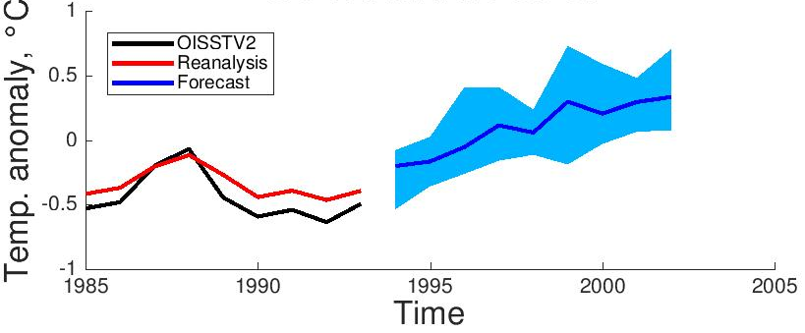
Advanced numerical models and data assimilation to accurately predict the ocean
Results from the Norwegian Climate Prediction Model
Prediction of North Atlantic Sea Surface Temperature, starting in October 1993
Model adjusted to observations
Prediction
Observations
Courtesy Yiguo Wang
Year
Back to main panel

Slide 26
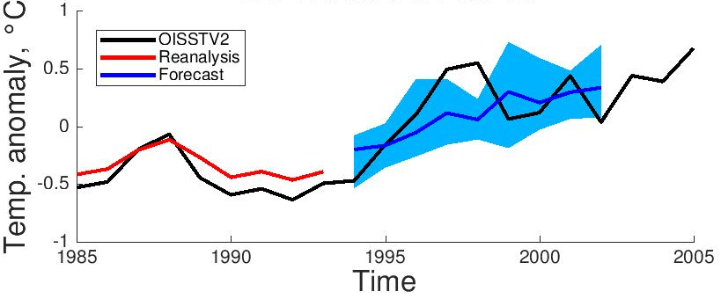
Advanced numerical models and data assimilation to accurately predict the ocean
Results from the Norwegian Climate Prediction Model
Prediction of North Atlantic Sea Surface Temperature, starting in October 1993
Model adjusted to observations
Prediction
Observations
Courtesy Yiguo Wang
Year
Back to main panel

Slide 27
Prediction skill is verified on past events by performing “hindcasts”
Figure shows multiple start dates, and forecast drift
Nadiga et al. 2019
Back to main panel

Slide 28
Current skill in predicting tropical Atlantic climate
Back to main panel

Slide 29
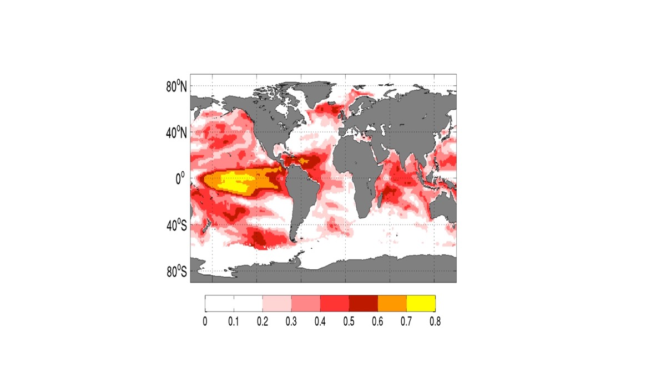
ENSO is the main source of seasonal prediction skill
Anomaly Correlation skill in predicting sea surface temperature at six months lead
N. American Multi-Model Ensemble (ave.), period 1985-2010
Anomaly Correlation
Keenlyside et al. 2020
Back to main panel

Slide 30
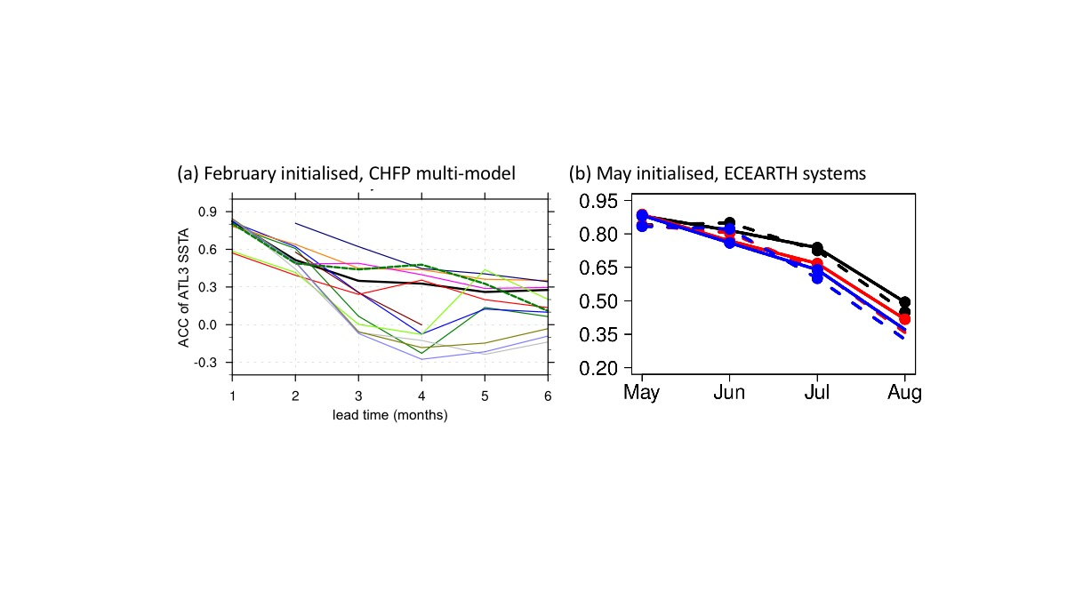
Atlantic Niño can only be predicted at 2-months lead
Anomaly correlation skill Atlantic-3 SST
Richter et al. 2018, Prodhomme et al. 2016
Back to main panel

Slide 31
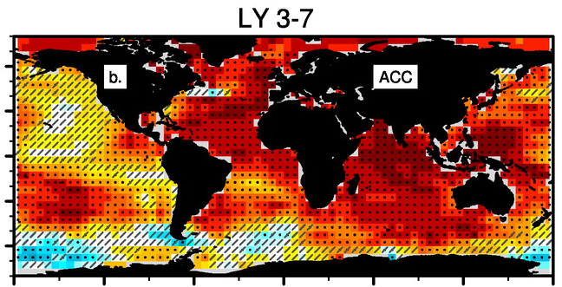
Climate prediction on multi-year timescales reaching useful skill levels in the Atlantic
Anomaly correlation skill in predicting sea surface temperature 3-7 years ahead
Model: CESM-DPLE, yearly reforecasts 1954-2015, 40 ensemble members
Back to main panel
Yeager et al. 2018

Slide 32
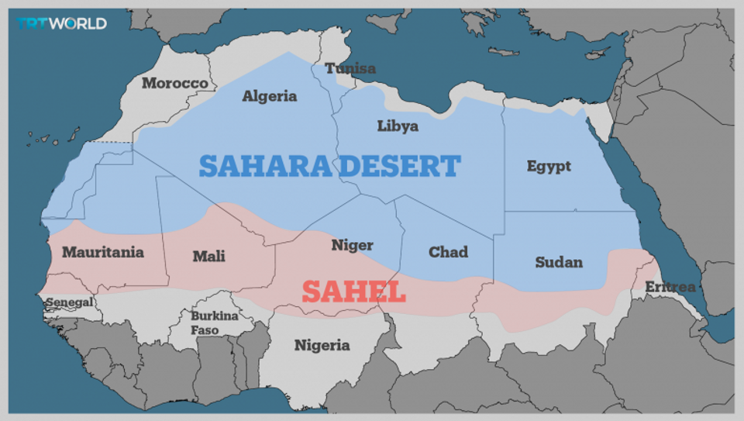
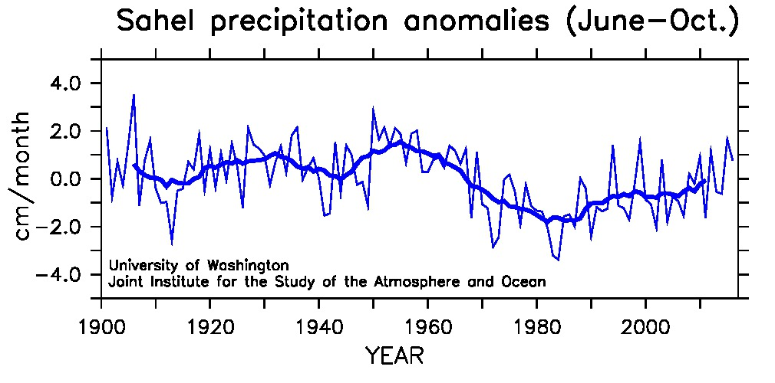
Climate prediction can increase societies resilience and ability for sustainable development
Predictions of Sahel rainfall, 2-5 years ahead
Sheen et al. 2017
Fink et al. 2010
2012 drought
18 million affected across the Sahel
Mauritania, 2012; Pablo Tosco/Oxfam
Back to main panel

Slide 33
Examples of marine ecosystem shifts in the tropical Atlantic
Back to main panel

Slide 34
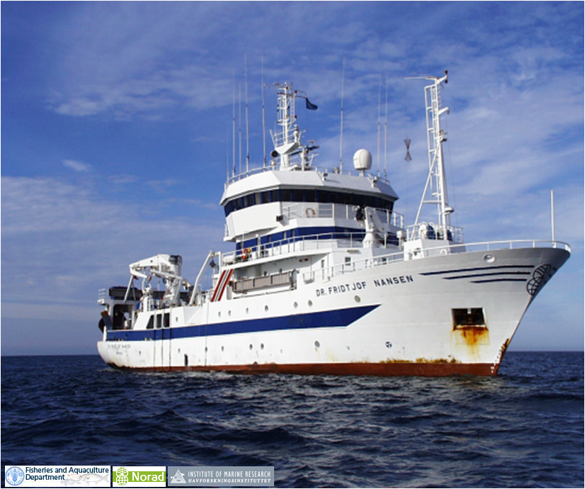
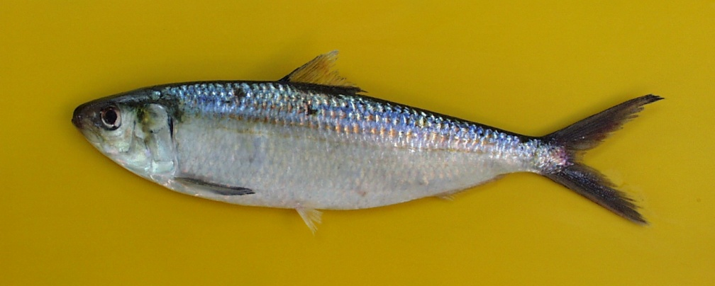
Climate and Ecosystems
The complexity of marine-ecosystems makes it difficult to assess climate variability impacts
As adults, small pelagic fish can swim to counter changes in their environment
Two examples of this are given for Sardinella in the North and South Eastern Atlantic
Data from Norwegian funded EAF Nansen Program
Back to main panel

Slide 35
West Africa: Sardinella shift northward because of long-term oceanic warming – Climate change and climate variability
Acoustic survey data show northward migration of Sardinella aurita
Data from RV Dr Fridtjof Nansen
Sarre et al., submitted
www.preface-project.eu
Back to main panel

Slide 36
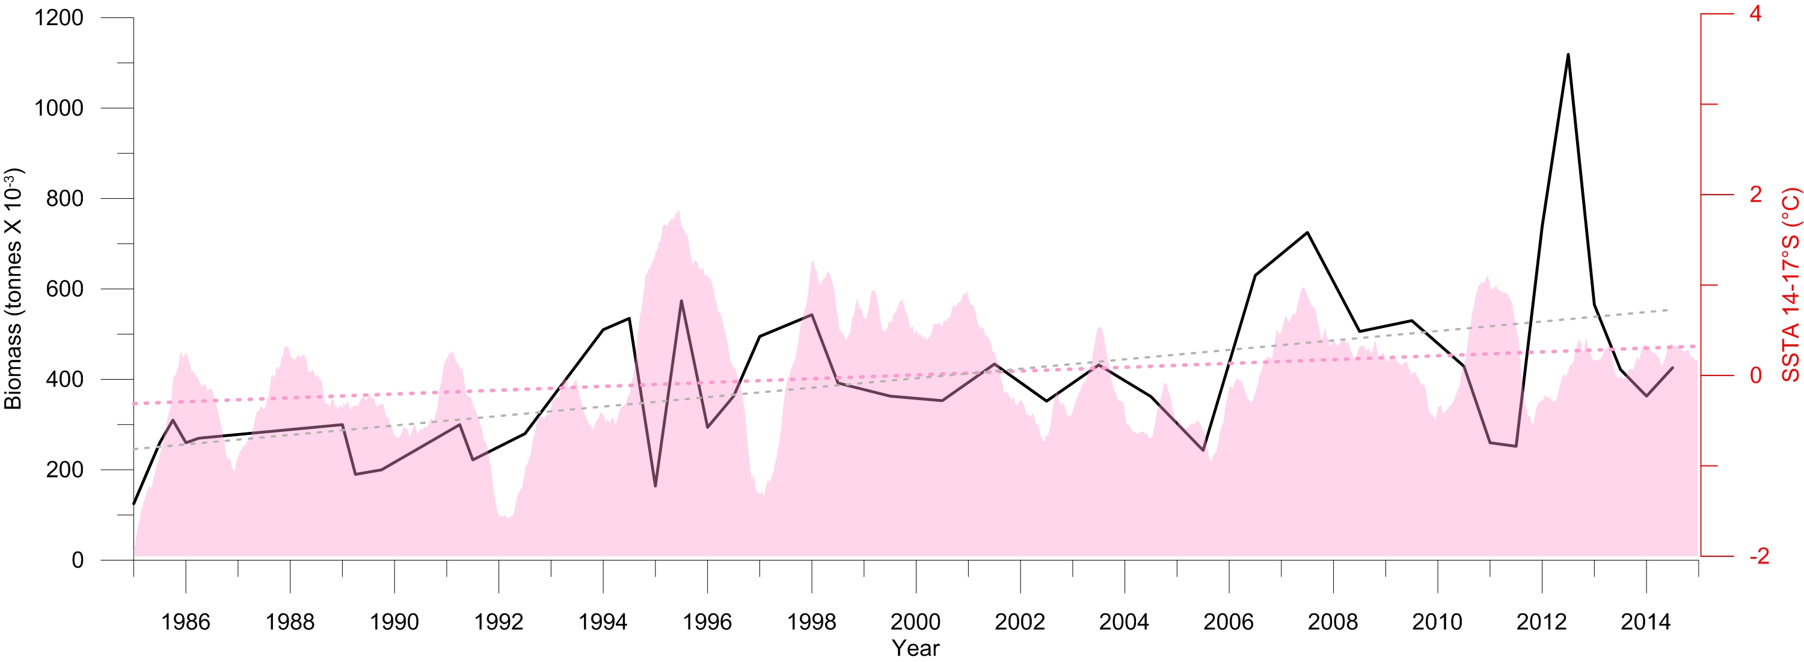
Sardinella biomass increase and Sea Surface Temperature along the Angolan Coast
Acoustically determined biomass of Sardinella spp. (solid black line)
Satellite-derived SST from the Angolan coast (in the background)
1200
4
Biomass (tonnes x 10³)
SST anomalies (°C)
-2
1996
2014
Year
Sangolay, B.B,Barradas A and M. Ostrowski
Back to main panel

Slide 37
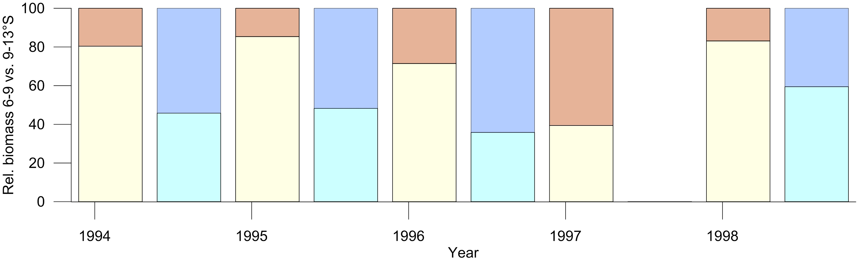
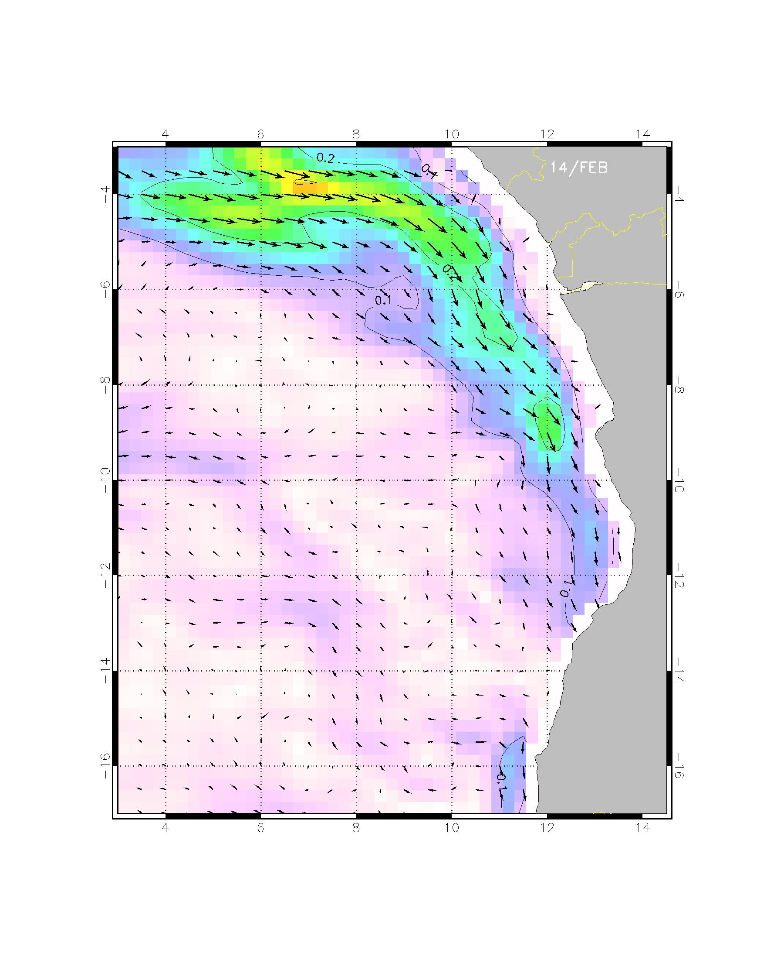
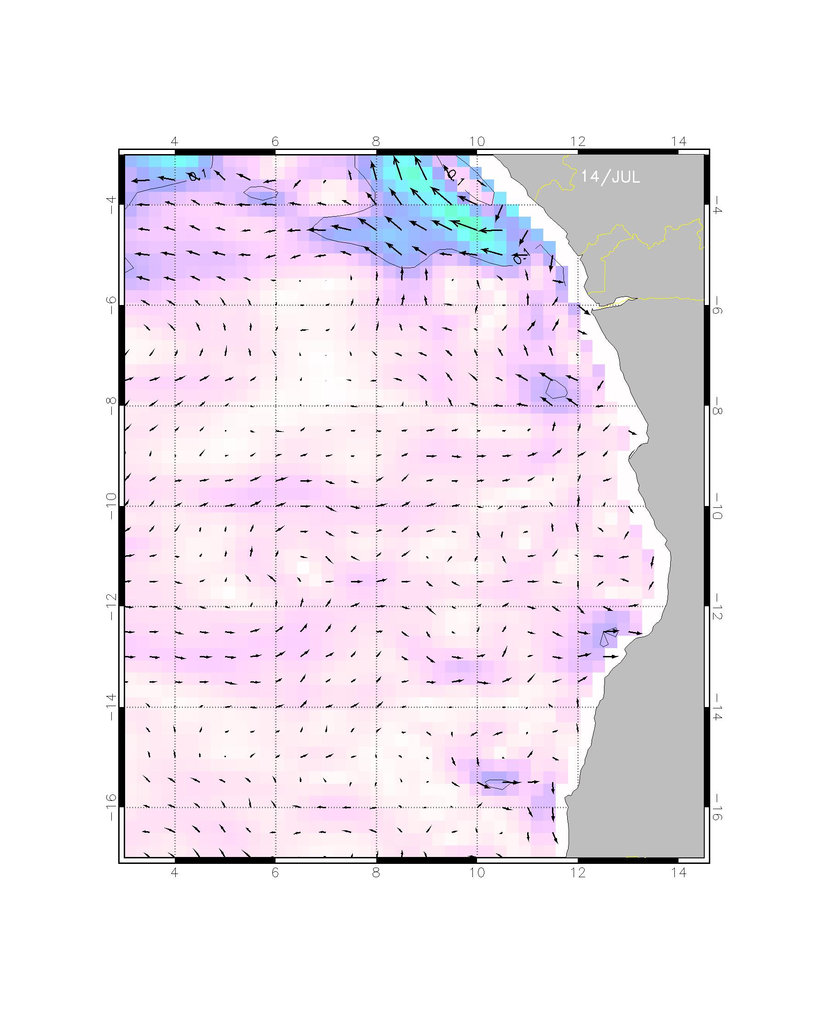
Circulation and biomass distribution.
Seasonal migrations of sardinella in Angolan waters
Proportion of biomass in the Northern versus Central region (1994-1998)
100
D1
U1
D1
U1
D1
U1
U1
D1
U1
D1
No data
0
1994 1995 1996 1997 1998
Surface currents
Downwelling (D1) = FEB-MAR
Upwelling (U1) = MAY-AUG
Northern region
Central region
Courtesy:
Ostrowski & Barradas
Feb – Mar (D1)
May-Aug (U1)
Back to main panel

Slide 38
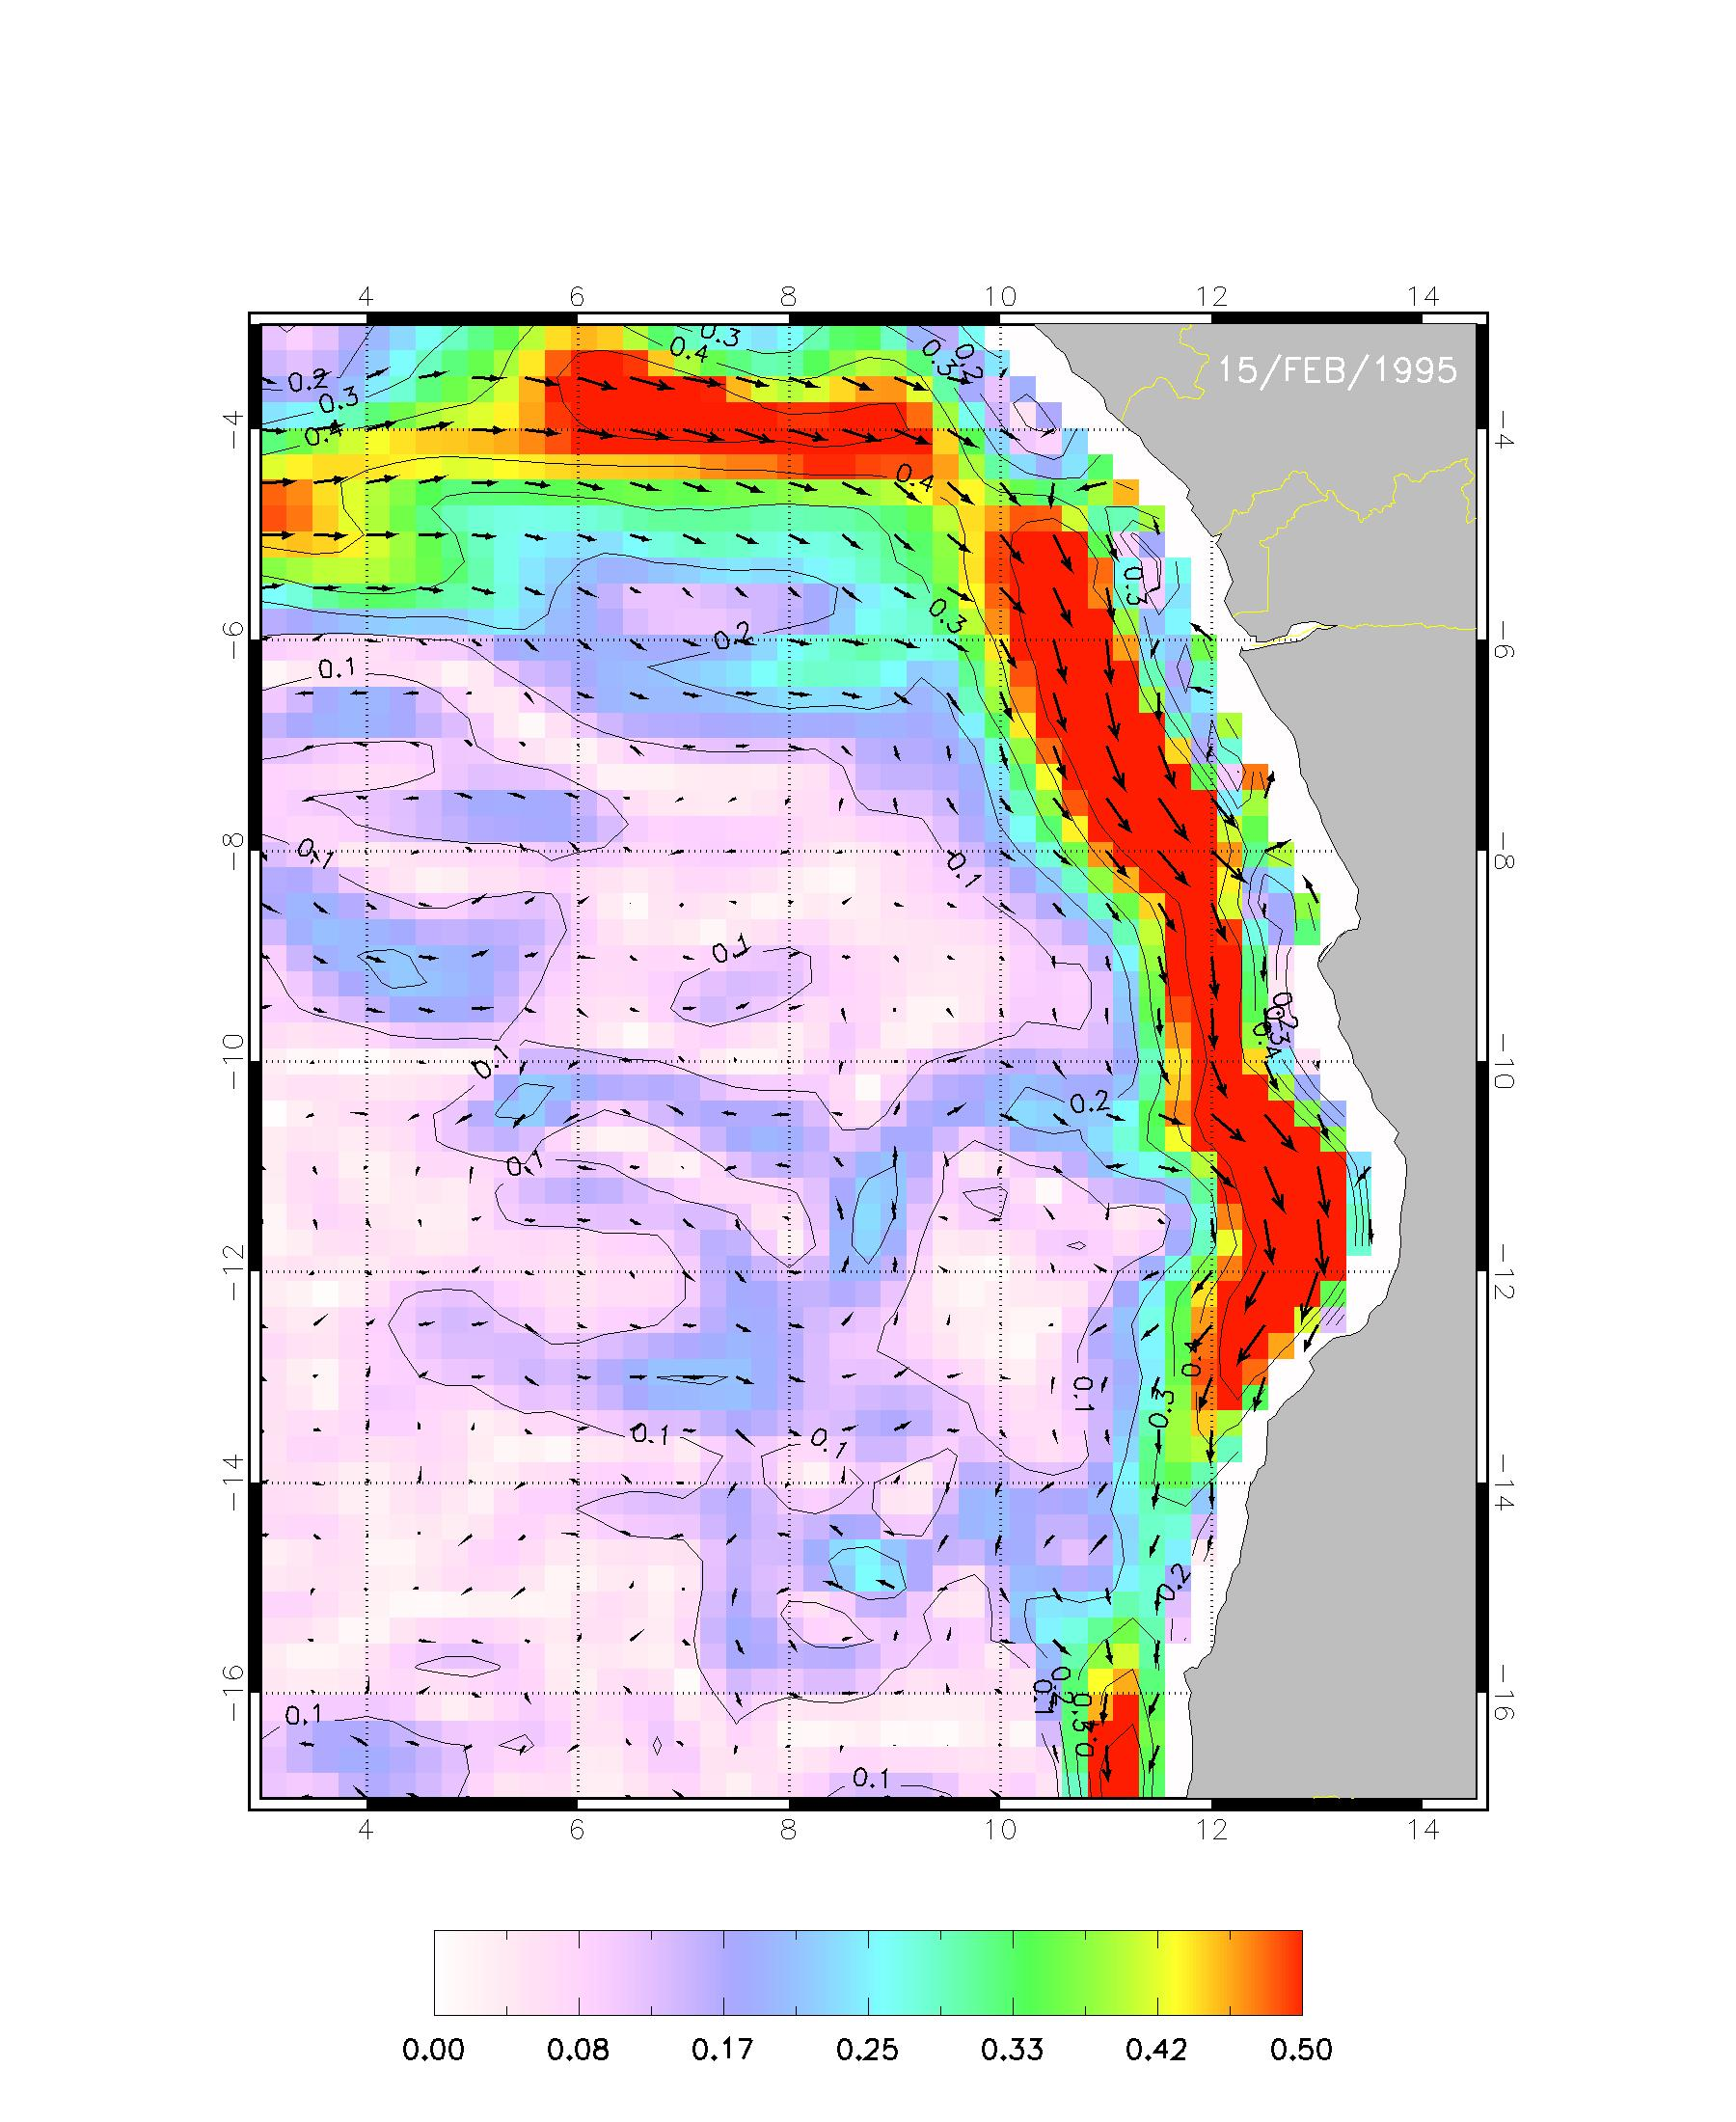
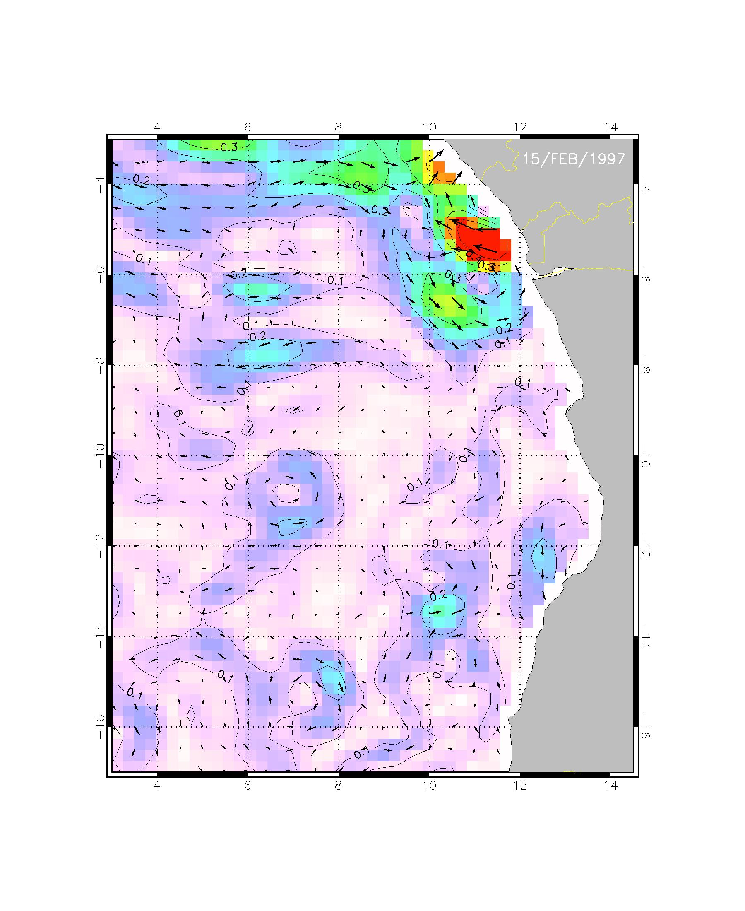
Interannual migrations of sardinella in
Angolan waters. Potential for prediction?
Proportion of biomass in the Northern versus Central region (1994-1998)
100
D1
U1
D1
U1
D1
U1
U1
D1
U1
D1
No data
0
1994 1995 1996 1997 1998
Surface currents
Downwelling (D1) = FEB-MAR
Upwelling (U1) = MAY-AUG
Northern region
Central region
Courtesy:
Ostrowski & Barradas
Feb 1995
Feb 1997
Back to main panel

Slide 39
Example of the potential to make climate based predictions
Back to main panel

Slide 40
Ocean-based statistical predict decline in
Barents Sea Cod stock
Statistical predictions seven years in advance
based on the AMO index and Faroe–Shetland Channel salinities
Årthun et al. 2018
Back to main panel

Slide 41
Discussion points
Long-term – is it interesting for fisheries?
  Signal large, but uncertainties large at regional level
  Uncertainties – from internal climate variability, from model error
Can short term predictions be more interesting for society
  Many aspects of decision making in society and management are focused on short term
Are marine ecosystem models ready to be coupled with climate predictions?
Is there enough data to verify predictions and build statistical prediction models?
Back to main panel

